Slide 1
Electronics Systems (938II)
Lecture 3.6
Semiconductor Memories – DRAM, SDRAM, and DDR

Slide 2
RAM – Reminder*
RAM classification
Static RAM (SRAM)
The memory content is hold over the time, as long as the memory is powered
Dynamic RAM (DRAM)
Even if the memory is powered, the memory content needs to be refreshed over the time, otherwise it is lost

Slide 3

RAM – Reminder*
RAM classification
Static RAM (SRAM)
The memory content is hold over the time, as long as the memory is powered
Dynamic RAM (DRAM)
Even if the memory is powered, the memory content needs to be refreshed over the time, otherwise it is lost

Slide 4





DRAM – Memory cell*
Capacitor
$$C$$

Slide 5
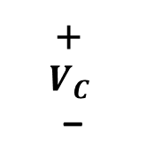

DRAM – Memory cell*
Capacitor
Memory bit = Voltage on capacitor ($V_{C}$)
+
$$V_{C}$$
–
$$C$$

Slide 6





DRAM – Memory cell*
Capacitor
Memory bit = Voltage on capacitor ($V_{C}$)
$V_{C}=\left\{\begin{aligned}V_{CC} (logic 1) \\ 0 \left(logic 0\right)\end{aligned}\right.$
+
$$V_{C}$$
–
$$C$$
$$V_{C}$$
$$V_{CC}$$
$0$
$$t$$

Slide 7




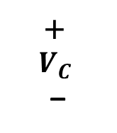
DRAM – Memory cell*
Architecture
Capacitor
1x access transistor
$WL_{i}$ = Word Line
$BL_{j}$ = Bit Line
$$BL_{j}$$
$$WL_{i}$$
+
$$V_{C}$$
–
$$C$$

Slide 8
DRAM – Memory cell*
Working principle
$$BL_{j}$$
$$WL_{i}$$
+
$$V_{C}$$
–
$$C$$

Slide 9

DRAM – Memory cell*
Working principle
Write
$WL_{i}=1$
$BL_{i}=D$
$0 V$ (logic $0$)
$V_{CC}$ (logic $1$)
$$BL_{j}$$
$$WL_{i}$$
+
$$V_{C}$$
–
$$C$$

Slide 10

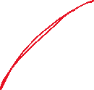






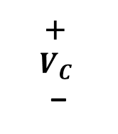


DRAM – Memory cell*
Working principle
Write
$WL_{i}=1$
$BL_{i}=D$
$0 V$ (logic $0$)
$V_{CC}$ (logic $1$)
$$BL_{j}$$
+
$$V_{C}$$
–
$$C$$
$$WL_{i}$$
+
$$V_{C}$$
–
$$C$$
$$V_{C}$$
$$V_{C}$$
$$V_{CC}$$
$$V_{CC}$$
$0$
$0$

Slide 11


DRAM – Memory cell*
Working principle
After write
$WL_{i}=0$
Assume 1 ($V_{CC}$) written in memory cell / on capacitor
$$BL_{j}$$
$$WL_{i}$$
$$V_{CC}$$
+
$$V_{C}$$
–
$$C$$

Slide 12


DRAM – Memory cell*
Working principle
After write
$WL_{i}=0$
Assume 1 ($V_{CC}$) written in memory cell / on capacitor
Access transistor $≈$ resistor (R)
High impedance when $WL_{i}=0$ (transistor OFF)
$$BL_{j}$$
$$WL_{i}$$
$$R$$
$$V_{CC}$$
+
$$V_{C}$$
–
$$C$$

Slide 13


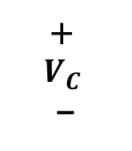

DRAM – Memory cell*
Working principle
After write
$WL_{i}=0$
Assume 1 ($V_{CC}$) written in memory cell / on capacitor
Access transistor $≈$ resistor (R)
High impedance when $WL_{i}=0$ (transistor OFF)
$$BL_{j}$$
$$WL_{i}$$
$$R$$
$$V_{CC}$$
+
$$V_{C}$$
–
$$C$$
+
$$V_{C}$$
–
$R$
$$C$$

Slide 14
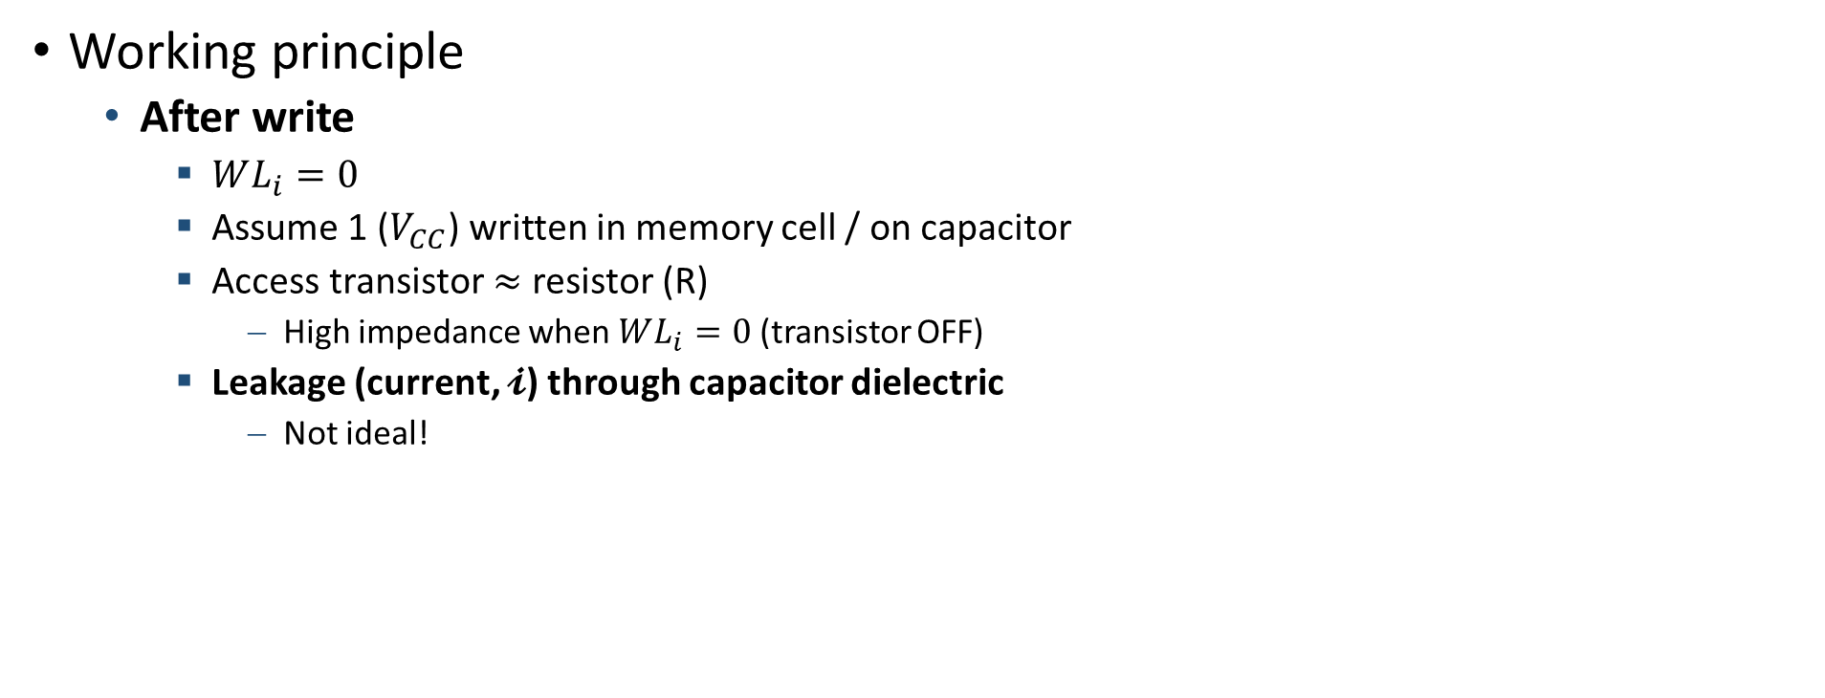
DRAM – Memory cell*
Working principle
After write
$WL_{i}=0$
Assume 1 ($V_{CC}$) written in memory cell / on capacitor
Access transistor $≈$ resistor (R)
High impedance when $WL_{i}=0$ (transistor OFF)
Leakage (current, $𝓲$) through capacitor dielectric
Not ideal!
$$BL_{j}$$
$$WL_{i}$$
$$V_{CC}$$
+
$$V_{C}$$
–
$$C$$
+
$$V_{C}$$
–
$R$
$$C$$

Slide 15
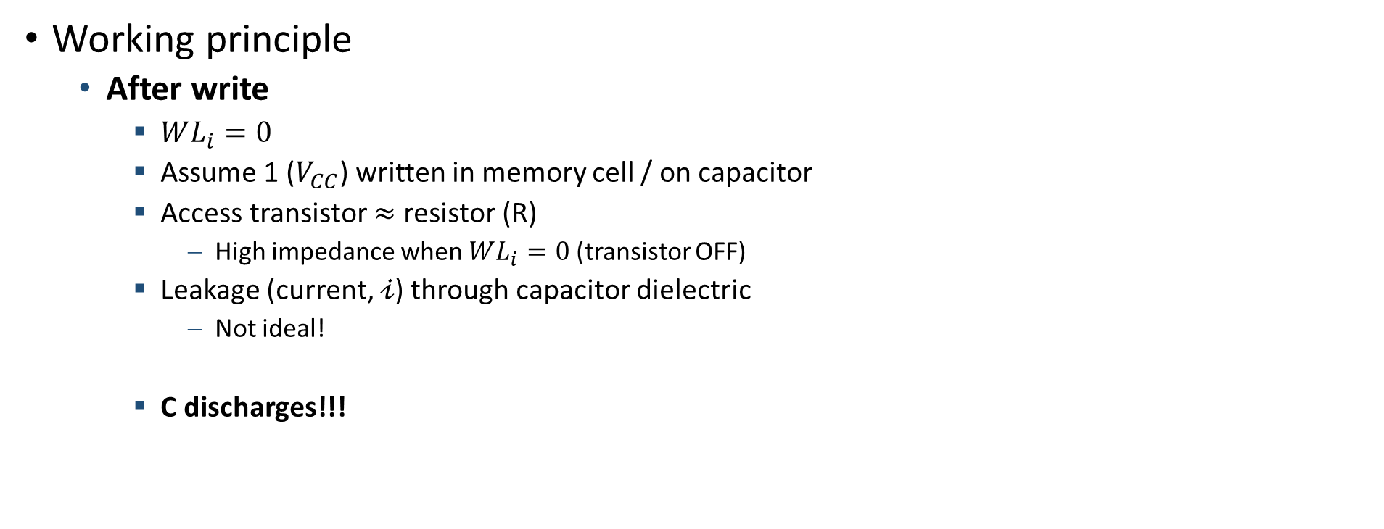
DRAM – Memory cell*
Working principle
After write
$WL_{i}=0$
Assume 1 ($V_{CC}$) written in memory cell / on capacitor
Access transistor $≈$ resistor (R)
High impedance when $WL_{i}=0$ (transistor OFF)
Leakage (current, $𝒾$) through capacitor dielectric
Not ideal!
C discharges!!!
$$BL_{j}$$
$$WL_{i}$$
$$V_{CC}$$
+
$$V_{C}$$
–
$$C$$
+
$$V_{C}$$
–
$R$
$$C$$

Slide 16



DRAM – Memory cell*
Working principle
After write
C discharges!!!
$$BL_{j}$$
$$WL_{i}$$
$$V_{CC}$$
$$V_{C}$$
+
$$V_{C}$$
–
$$C$$
$$V_{CC}$$
+
$$V_{C}$$
–
$R$
$$C$$
$0$
write

Slide 17

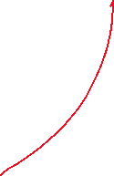
DRAM – Memory cell*
Working principle
After write
C discharges!!!
Proportional to $R∙C=τ$ (time constant)
$$BL_{j}$$
$$WL_{i}$$
$$V_{CC}$$
$$V_{C}$$
+
$$V_{C}$$
–
$$C$$
$$V_{CC}$$
+
$$V_{C}$$
–
$R$
$$C$$
$0$
write

Slide 18

DRAM – Memory cell*
Working principle
After write
C discharges!!!
Proportional to $R∙C=τ$ (time constant)
$τ=10÷100 ms$
$$BL_{j}$$
$$WL_{i}$$
$$V_{CC}$$
$$V_{C}$$
+
$$V_{C}$$
–
$$C$$
$$V_{CC}$$
+
$$V_{C}$$
–
$R$
$$C$$
$0$
write

Slide 19

DRAM – Memory cell*
Working principle
After write
C discharges!!!
Proportional to $R∙C=τ$ (time constant)
$τ=10÷100 ms$
Need of refresh
$$BL_{j}$$
$$WL_{i}$$
$$V_{CC}$$
$$V_{C}$$
+
$$V_{C}$$
–
$$C$$
$$V_{CC}$$
+
$$V_{C}$$
–
$R$
$$C$$
$0$
write

Slide 20
DRAM – Memory cell*
Working principle
After write
C discharges!!!
Proportional to $R∙C=τ$ (time constant)
$τ=10÷100 ms$
Need of refresh
$$BL_{j}$$
$$WL_{i}$$
$$V_{CC}$$
$$V_{C}$$
+
$$V_{C}$$
–
refresh
$$C$$
$$V_{CC}$$
+
$$V_{C}$$
–
$R$
$$C$$
$0$
write

Slide 21
DRAM – Memory cell*
Working principle
After write
C discharges!!!
Proportional to $R∙C=τ$ (time constant)
$τ=10÷100 ms$
Need of refresh
$$BL_{j}$$
$$WL_{i}$$
$$V_{CC}$$
$$V_{C}$$
+
$$V_{C}$$
–
refresh
refresh
refresh
$$C$$
$$V_{CC}$$
+
$$V_{C}$$
–
$R$
$$C$$
$0$
write
refresh
refresh

Slide 22
DRAM – Memory cell*
Working principle
Read
$$BL_{j}$$
$$WL_{i}$$
+
$$V_{C}$$
–
$$C$$

Slide 23



DRAM – Memory cell*
Working principle
Read
Step 1
$WL_{i}=0$
$BL_{j}=\frac{V_{CC}}{2}=V_{R}$ (reading voltage)
$$BL_{j}$$
$$WL_{i}$$
+
$$V_{C}$$
–
$$C$$

Slide 24

DRAM – Memory cell*
Working principle
Read
Step 1
$WL_{i}=0$
$BL_{j}=\frac{V_{CC}}{2}=V_{R}$
Step 2
$WL_{i}=1$
$$BL_{j}$$
$$WL_{i}$$
+
$$V_{C}$$
–
$$C$$

Slide 25

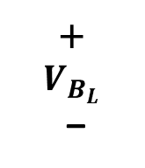

DRAM – Memory cell*
Working principle
Read
Step 1
$WL_{i}=0$
$BL_{j}=\frac{V_{CC}}{2}=V_{R}$
Step 2
$WL_{i}=1$
$BL_{j}≈C_{B_{L}}$ (capacitor)
$C_{B_{L}}≫C$
$V_{B_{L}}$ = voltage on $C_{B_{L}}$
$$BL_{j}$$
$$WL_{i}$$
+
$V_{B_{L}}$
–
+
$$V_{C}$$
–
$$C_{B_{L}}$$
$$C$$

Slide 26
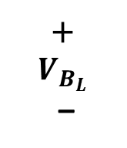


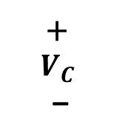

DRAM – Memory cell*
+
$V_{B_{L}}$
–
+
$$V_{C}$$
–
Working principle
Read
Step 1
$WL_{i}=0$
$BL_{j}=\frac{V_{CC}}{2}=V_{R}$
Step 2
$WL_{i}=1$
$BL_{j}≈C_{B_{L}}$ (capacitor)
$C_{B_{L}}≫C$
$V_{B_{L}}$ = voltage on $C_{B_{L}}$
$$BL_{j}$$
$$C$$
$$C_{B_{L}}$$
$$WL_{i}$$
+
$V_{B_{L}}$
–
+
$$V_{C}$$
–
$$C_{B_{L}}$$
$$C$$

Slide 27

DRAM – Memory cell*
+
$V_{B_{L}}$
–
+
$$V_{C}$$
–
Working principle
Read
Step 1
$WL_{i}=0$
$BL_{j}=\frac{V_{CC}}{2}=V_{R}$
Step 2
$WL_{i}=1$
$BL_{j}≈C_{B_{L}}$ (capacitor)
$C_{B_{L}}≫C$
$V_{B_{L}}$ = voltage on $C_{B_{L}}$
Charge redistribution between $C_{B_{L}}$ and $C$ !
$$BL_{j}$$
$$C$$
$$C_{B_{L}}$$
$$WL_{i}$$
+
$V_{B_{L}}$
–
+
$$V_{C}$$
–
$$C_{B_{L}}$$
$$C$$

Slide 28





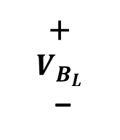





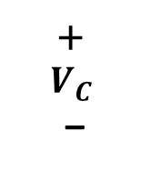










DRAM – Memory cell*
Working principle
Read
Charge redistribution!
Read destroys data!
Need of re-write!
Memory bit = 1 ($V_{C}=V_{CC}$)
Memory bit = 0 ($V_{C}=0 V$)
$V_{B_{L}}$
$V_{B_{L}}$
$V_{CC}$
$V_{CC}$
+
$V_{B_{L}}$
–
+
$$V_{C}$$
–
$V_{R}$
$V_{R}$
$$C$$
$$C_{B_{L}}$$
$0$
$0$
$V_{C}$
$V_{C}$
$V_{CC}$
$V_{CC}$
$V_{R}$
$V_{R}$
$0$
$0$

Slide 29



DRAM – Memory cell*
Working principle
Read
Charge redistribution!
Read destroys data!
Memory bit = 1 ($V_{C}=V_{CC}$)
Memory bit = 0 ($V_{C}=0 V$)
$V_{B_{L}}$
$V_{B_{L}}$
$V_{CC}$
$V_{CC}$
+
$V_{B_{L}}$
–
+
$$V_{C}$$
–
$V_{R}$
$V_{R}$
$$C$$
$$C_{B_{L}}$$
$0$
$0$
$V_{C}$
$V_{C}$
$V_{CC}$
$V_{CC}$
$V_{R}$
$V_{R}$
$0$
$0$

Slide 30



DRAM – Memory cell*
Working principle
Read
Charge redistribution!
Read destroys data!
Need of re-write!
Memory bit = 1 ($V_{C}=V_{CC}$)
Memory bit = 0 ($V_{C}=0 V$)
$V_{B_{L}}$
$V_{B_{L}}$
$V_{CC}$
$V_{CC}$
+
$V_{B_{L}}$
–
+
$$V_{C}$$
–
$V_{R}$
$V_{R}$
$$C$$
$$C_{B_{L}}$$
$0$
$0$
$V_{C}$
$V_{C}$
$V_{CC}$
$V_{CC}$
$V_{R}$
$V_{R}$
$0$
$0$

Slide 31

DRAM – Memory cell*
Working principle
Read
How to re-write?
If $V_{B_{L}}>V_{R}$ → 1
If $V_{B_{L}}<V_{R}$ → 0
Memory bit = 1 ($V_{C}=V_{CC}$)
Memory bit = 0 ($V_{C}=0 V$)
$V_{B_{L}}$
$V_{B_{L}}$
$V_{CC}$
$V_{CC}$
$V_{R}$
$V_{R}$
$0$
$0$
$V_{C}$
$V_{C}$
$V_{CC}$
$V_{CC}$
$V_{R}$
$V_{R}$
$0$
$0$

Slide 32

DRAM – Memory cell*
Working principle
Read
How to re-write?
If $V_{B_{L}}>V_{R}$ → 1
If $V_{B_{L}}<V_{R}$ → 0
$\left|V_{B_{L}}−V_{R}\right|$
Very small value
Must be amplified!
Memory bit = 1 ($V_{C}=V_{CC}$)
Memory bit = 0 ($V_{C}=0 V$)
$V_{B_{L}}$
$V_{B_{L}}$
$V_{CC}$
$V_{CC}$
$V_{R}$
$V_{R}$
$0$
$0$
$V_{C}$
$V_{C}$
$V_{CC}$
$V_{CC}$
$V_{R}$
$V_{R}$
$0$
$0$

Slide 33

DRAM – Memory cell*
Working principle
Read
How to re-write?
If $V_{B_{L}}>V_{R}$ → 1
If $V_{B_{L}}<V_{R}$ → 0
$\left|V_{B_{L}}−V_{R}\right|$
Very small value
Must be amplified!
Sense Amplifier (SA)
Memory bit = 1 ($V_{C}=V_{CC}$)
Memory bit = 0 ($V_{C}=0 V$)
$V_{B_{L}}$
$V_{B_{L}}$
$V_{CC}$
$V_{CC}$
$V_{R}$
$V_{R}$
$0$
$0$
$V_{C}$
$V_{C}$
$V_{CC}$
$V_{CC}$
$V_{R}$
$V_{R}$
$0$
$0$

Slide 34


DRAM – Architecture and working principle*
Draft
Sense Amplifier (SA)
SA
$W$

Slide 35
DRAM – Architecture and working principle*
Draft
Sense Amplifier (SA)
How?
Bistable !
We have already seen in SRAM
SA
$W$

Slide 36
DRAM – Architecture and working principle*
Draft
Sense Amplifier (SA)
How?
Bistable !
We have already seen in SRAM
$W$

Slide 37

DRAM – Architecture and working principle*
Draft
Sense Amplifier (SA)
Write ($W = 1$)
Bistable is bypassed (OFF)
Write value on Bit Line
$W$

Slide 38


DRAM – Architecture and working principle*
Draft
Sense Amplifier (SA)
Write ($W = 1$)
Bistable is bypassed (OFF)
Write value on Bit Line
Read ($W =0$)
Bistable is ON
Bistable regenerates memory bit ($V_{C}$)
$W$

Slide 39

DRAM – Architecture and working principle*
Draft
Bit Lines are “big” capacitors ($C_{B_{L}}$)
SAs placed in the middle (of each BL) for balancing capacitive load ($C_{B_{L}}$)
In addition
SA block merged with the column-decoder for resource saving and architecture simplification

Slide 40
DRAM – Architecture and working principle*
Draft

Slide 41
DRAM – Architecture and working principle*
Draft
memory cell

Slide 42
DRAM – Architecture and working principle*
Draft
memory cell
Upper half
Lower half

Slide 43




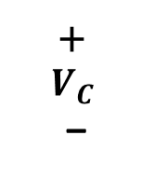
DRAM – Architecture and working principle*
Draft
Other problem(s)
When reading (or writing)
$WL_{i}$ moves from 0 to 1
$$BL_{j}$$
$$WL_{i}$$
+
$$V_{C}$$
–
$$C$$

Slide 44
DRAM – Architecture and working principle*
Draft
Other problem(s)
When reading (or writing)
$WL_{i}$ moves from 0 to 1
$$BL_{j}$$
$$WL_{i}$$
+
$$V_{C}$$
–
$$C$$

Slide 45



DRAM – Architecture and working principle*
Draft
Other problem(s)
When reading (or writing)
$WL_{i}$ moves from 0 to 1
Capacitive coupling between $WL_{i}$ and $BL_{j}$
$$BL_{j}$$
$$WL_{i}$$
+
$$V_{C}$$
–
$$C$$

Slide 46

DRAM – Architecture and working principle*
Draft
Other problem(s)
When reading (or writing)
$WL_{i}$ moves from 0 to 1
Capacitive coupling between $WL_{i}$ and $BL_{j}$
To counteract this, the capacitive load seen by the SA must be balanced !
$$BL_{j}$$
$$WL_{i}$$
+
$$V_{C}$$
–
$$C$$

Slide 47



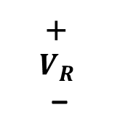



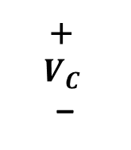


DRAM – Architecture and working principle*
Real memory cell (upper half)
Draft
Balancing capacitive load seen by SA
Same distance $ℓ$ in opposite directions
Same $WL_{i}$
Dummy memory cell
Opposite half
Preloaded at $V_{R}$
$$WL_{i}$$
+
$$V_{C}$$
–
$$C$$
$ℓ$
$$WL_{i}$$
$ℓ$
Dummy memory cell (lower half)
+
$$V_{R}$$
–
$$C$$
$$BL_{j}$$

Slide 48
DRAM – Architecture and working principle*
Real memory cell
Draft
Including dummy cells
Dummy memory cell

Slide 49
DRAM – Architecture and working principle*
Draft
Including dummy cells
Example
Balancing upper half

Slide 50
DRAM – Architecture and working principle*
Draft
Including dummy cells
Example
Balancing lower half

Slide 51
DRAM – Architecture and working principle*
Final
To complete the architecture, they should be integrated
Address
Write command/signal
Input data (D) and output data (Q) ports

Slide 52
DRAM – Architecture and working principle*
Final
To complete the architecture, they should be integrated
Address
Write command/signal
Input data (D) and output data (Q) ports
To reduce costs/save resources
Single I/O port
Single address port shared by row and column decoders
Buffer to store row/column address
RAB = Row Address Buffer ← triggered by signal RAS = Row Address Strobe
CAB = Column Address Buffer ← triggered by signal CAS = Column Address Strobe

Slide 53
DRAM – Architecture and working principle*
Final
A = address port
Q = output (data) port
D = input (data) port
W = write command

Slide 54
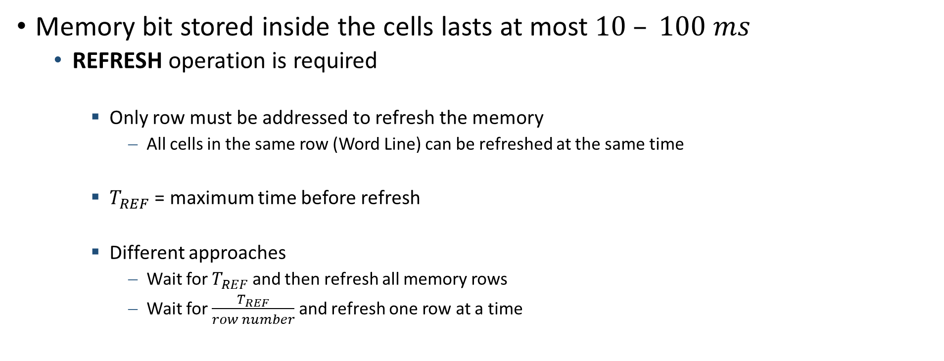
DRAM – Architecture and working principle*
Memory bit stored inside the cells lasts at most $10 – 100 ms$
REFRESH operation is required
Only row must be addressed to refresh the memory
All cells in the same row (Word Line) can be refreshed at the same time
$T_{REF}$ = maximum time before refresh
Different approaches
Wait for $T_{REF}$ and then refresh all memory rows
Wait for $\frac{T_{REF}}{row number}$ and refresh one row at a time

Slide 55

DRAM – Architecture and working principle*
Memory bit stored inside the cells lasts at most $10 – 100 ms$
REFRESH operation is required
DRAM “knows” where (which row) to perform the refresh
Counter
Processor/CPU “knows” when to perform the refresh
Timer

Slide 56
SDRAM*
Modern DRAMs are synchronous
Control and data operations referenced to a common clock signal
SDRAM = Synchronous DRAM
Burst mode
Initial latency followed by a flood of data

Slide 57
DDR*
DDR = Double Data Rate
SDRAM in which control and data operations are performed on both edges of clock signal
Rising edge
Falling edge
Data transfer rate is doubled!
From here the name
Standardized throughout the years

Slide 58
DDR*

Slide 59
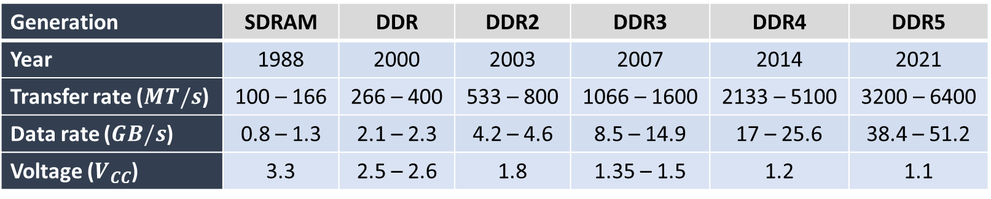


DDR*
Standards/generations
Generation | SDRAM | DDR | DDR2 | DDR3 | DDR4 | DDR5
Year | 1988 | 2000 | 2003 | 2007 | 2014 | 2021
Transfer rate ($MT/s$) | 100 – 166 | 266 – 400 | 533 – 800 | 1066 – 1600 | 2133 – 5100 | 3200 – 6400
Data rate ($GB/s$) | 0.8 – 1.3 | 2.1 – 2.3 | 4.2 – 4.6 | 8.5 – 14.9 | 17 – 25.6 | 38.4 – 51.2
Voltage ($V_{CC}$) | 3.3 | 2.5 – 2.6 | 1.8 | 1.35 – 1.5 | 1.2 | 1.1

